Slide 1
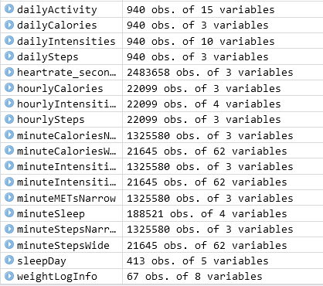
Data structure
Daily records | Hourly records | Minute records | Seconds record
dailyActivity dailyCalories dailyIntensities dailySteps sleepDay weightLogInfo | hourlyCalories hourlyIntensities hourlySteps | minuteCaloriesNarrow minuteCaloriesWide minuteIntensitiesNarrow minuteIntensitiesWide minuteMETsNarrow minuteSleep minuteStepsNarrow minuteStepsWide | heartrate_seconds
Data credibility:
The data is collected through a survey conducted by Amazon Mechanical Turk which is a credible source and the data is directly from the Fitbit tracking device.
Total no of participants in this data tracking = 33

Slide 2
Data structure
Observations:
Files can be categorized into 3 main types of time series - daily records, hourly records and records by minutes.
All files and records are linked by a common Key field called "Id“
The daily files contains data for all 33 participants (activity, calories, intensities, steps, sleep)
By viewing the daily files, it can be seen that only about 1 month of data is available in this dataset (4/12 - 5/12)
Sleep time information is available for 24 out of 33 participants
Heart rate records is available for only 14 out of the 33 participants in this surveyed dataset
Weight log information is available for only 8 out of 33 participants
Some files are available in both long and wide format (e.g. minuteStepsNarrow and minuteStepsWide)
MET = Metabolic Equivalent. Need to understand what the MET numbers mean.
The participants are identified by Id number but there is no direct indication of the gender (male or female)
Conclusions :
The data set is limited to only 33 individuals/participants. It is not clear how many of these are women.
For analyzing fitness trends in women, it is likely that the sample size is statistically insufficient to draw conclusions, with a high level of confidence.

Slide 3
Folder structure
Project
ASK
References
Working files
PREPARE
References
Deliverables
Working Files
Deliverables
PROCESS
References
Working Files
Deliverables
R-Markup
Change Log
Project folder structure
Data integrity
Scope Of Work
AIMS
Data source & model
ANALYZE
References
Working Files
Deliverables
SHARE
References
Working Files
Deliverables
ACT
References
Working Files
Deliverables
Dashboard / Visualization
Summary of Analysis
Presentation
Project (contd)
Recommendations

